Slide 1
Why visualize?

Slide 2
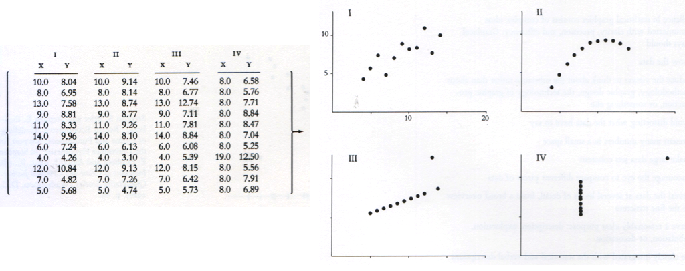
Anscombe’s Quartet
N = 11
Mean of X = 9
Mean of Y = 7.5
Variance of X = 11
Variance of Y = 4.1
Cor(X,Y) = 0.816

Slide 3
Anscombe’s Quartet

Slide 4
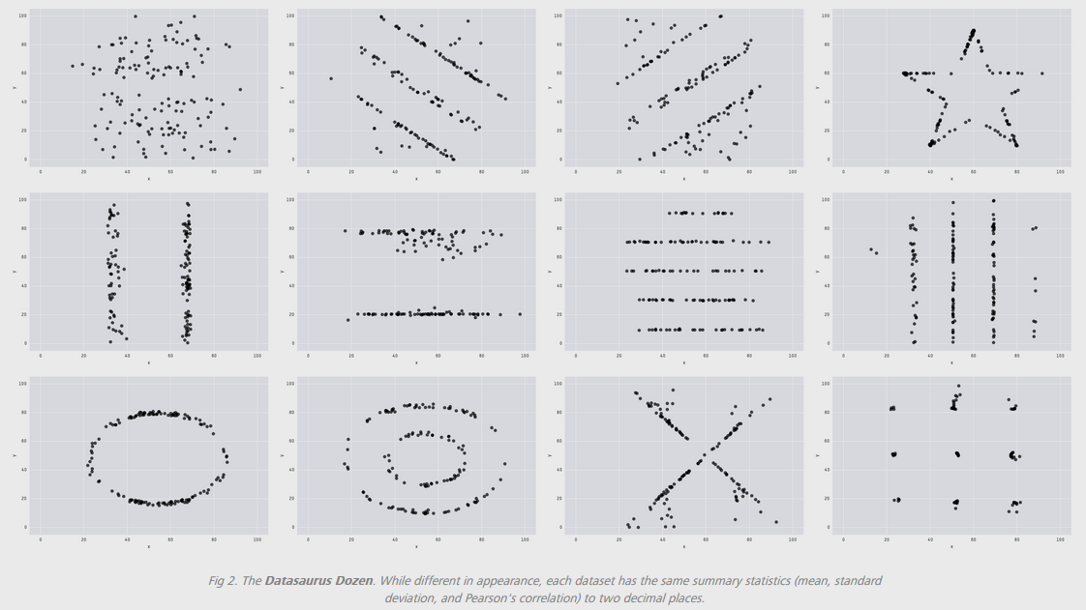
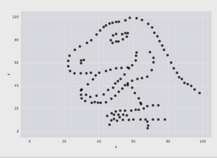
Datasaurus dozen
E(X) = 54.26; E(Y) = 47.83; SD(X) = 16.76; SD(Y) = 26.93; Cor(X,Y) = -0.06
Justin Matejka & George Fitzmaurice: https://www.autodeskresearch.com/publications/samestats

Slide 5
Principles of effective data visualization

Slide 6
What is an effective graph?
An effective graph encodes quantitative information in a way that allows viewers to quickly and easily decode the information.
(Naomi Robbins, Creating More Effective Graphs, p6, paraphrased)

Slide 7
For each of the following graphs:
What information is encoded in the visualization?
What information is easy to extract?
What information is difficult to extract?
What could be done to improve the readability of the visualization?

Slide 8
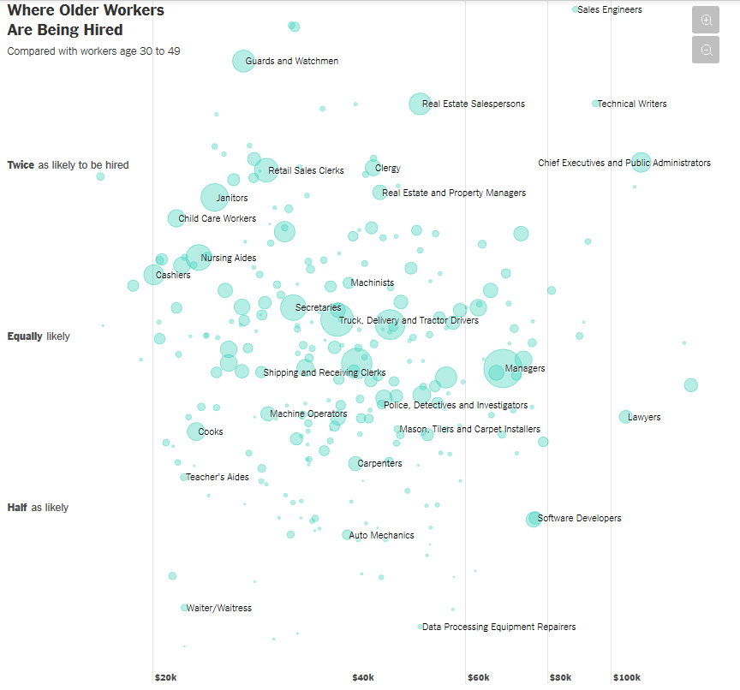
Graph 1
http://nyti.ms/2pC2HZv

Slide 9
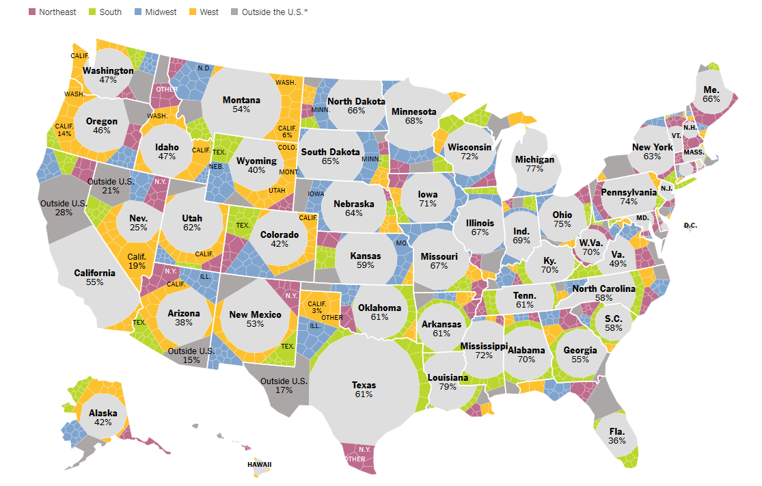
Graph 2
http://nyti.ms/2qwlIS6

Slide 10
How to make effective graphs?

Slide 11
1. Understand how we perceive differences

Slide 12


http://bit.ly/2q6aNgY

Slide 13
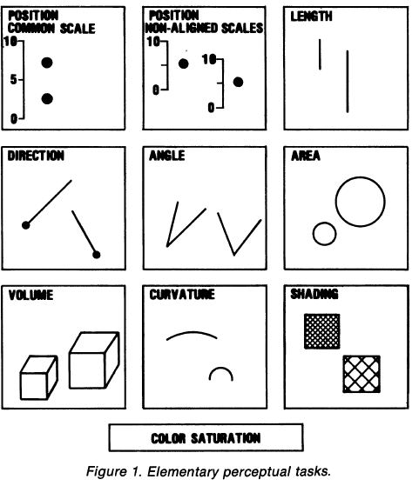
Elementary Perceptual Tasks (EPTs)
Cleveland & McGill, p532

Slide 14
Which represents the larger value? Which EPT did you use?
From Stat 405 notes by Hadley Wickham

Slide 15
Which represents the larger value? Which EPT did you use?
From Stat 405 notes by Hadley Wickham

Slide 16
Hue
Saturation
Value
HSV: 3 dimensions of color

Slide 17
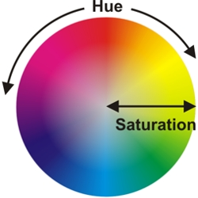

Slide 18
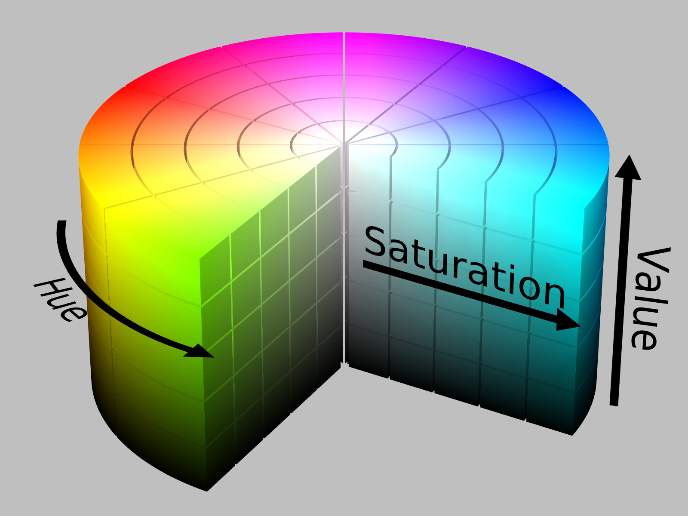
https://chroma.readthedocs.io/en/latest/

Slide 19
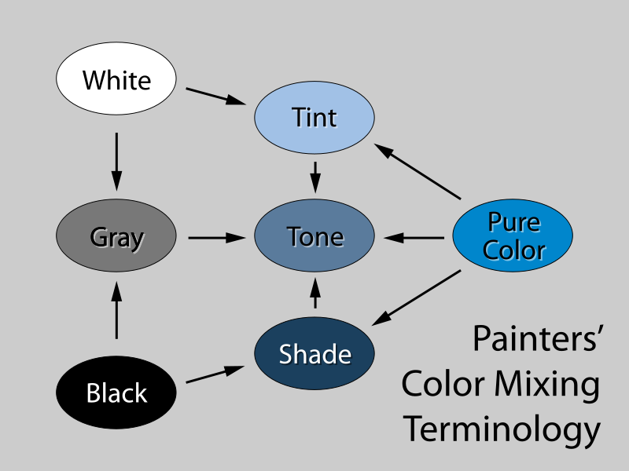
Saturation (aka “color ramp”)
Value
(aka “gray ramp”)
http://www.beginnersschool.com/2015/10/27/basic-color-theory/

Slide 20


Saturation = 1, Value = 1
Hue = 2/3
Hue = 0

Slide 21


Hue = 0, Value = 1
Saturation = 0.2
Saturation = 0.5
Saturation = 1

Slide 22


Hue = 0, Saturation = 1
Value = 0.5
Value = 0.8
Value = 1

Slide 23


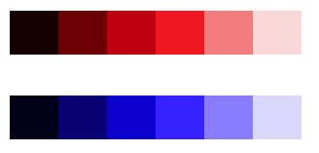
Issues with HSV
6 hues, same value, different perceived lightness:
Converting to grayscale:
Equidistant changes in value not created equal; red step appears much more drastic than blue step:
https://www.vis4.net/blog/posts/avoid-equidistant-hsv-colors/

Slide 24

Hue Chroma Luminance
6 hues on HSV scale; same saturation and value:
Same hues using HCL scale; same chroma and luminance:
https://www.vis4.net/blog/posts/avoid-equidistant-hsv-colors/

Slide 25
2. Match EPTs to data type (quantitative, ordinal, nominal)

Slide 26
Which represents the larger value? Which EPT did you use?

Slide 27
Which represents the larger value? Which EPT did you use?

Slide 28
EPT | Ordered? | Appropriate for:
Position | Yes | Quantitative, ordinal, nominal
Size (length, angle, volume) | Yes | Quantitative, ordinal, nominal
Saturation (color ramp) | Yes | Quantitative, ordinal, nominal
Value (gray ramp) | Yes | Quantitative, ordinal, nominal
Hue | No | Nominal only
Shape | No | Nominal only

Slide 29
3. Exploit our most efficient EPTs

Slide 30
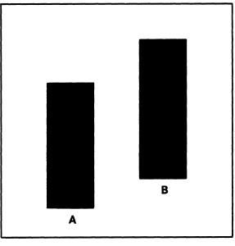
Which quantity is largest?
Which EPT are you using?
From Cleveland and McGill, p 538

Slide 31
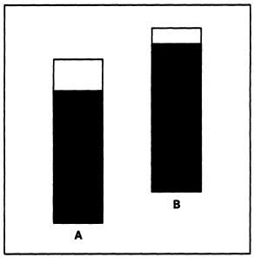
Which quantity is largest?
Which EPT are you using?
From Cleveland and McGill, p 538

Slide 32
Better yet…

Slide 33
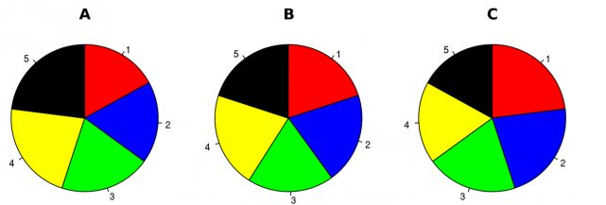
Hypothetical polling data on 5 candidates at initial time point A.
Rank the candidates in terms of their share of the vote.
Which EPT are you using?
Walter Hickey at Business Insider

Slide 34
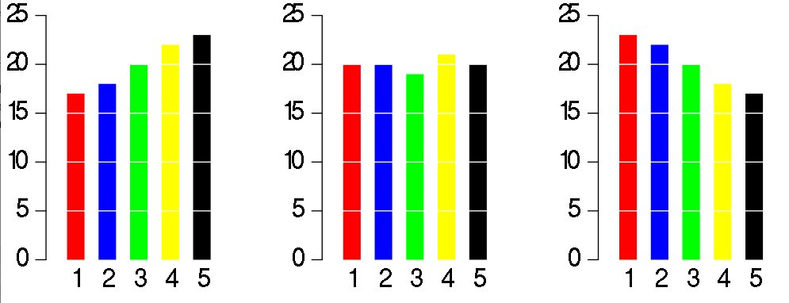
Same data, different graph
Which EPT are you using now?
Walter Hickey at Business Insider

Slide 35
Back to Cleveland and McGill…what is the size of Quantity A relative to Quantity B?
a
b
Figures revised by Hadley Wickham

Slide 36
What about now?
a
b
Figures revised by Hadley Wickham

Slide 37
What about now?
a
b
Figures revised by Hadley Wickham

Slide 38
What about now?
b
a
Figures revised by Hadley Wickham

Slide 39
What about now?
b
a
Figures revised by Hadley Wickham

Slide 40
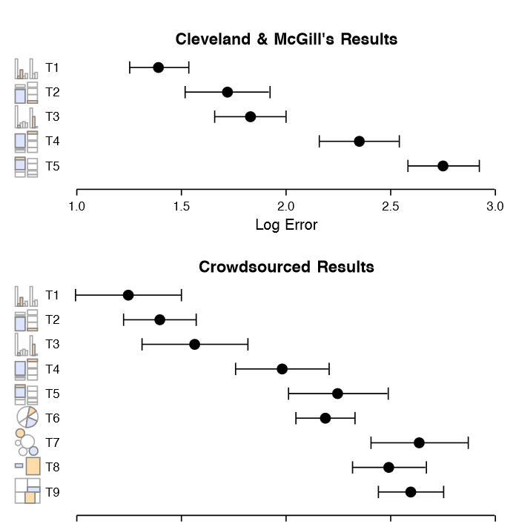
J. Heer and
M. Bostock. Crowdsourcing graphical perception: Using mechanical turk to assess visualization design. In CHI 2010, 2010.

Slide 41
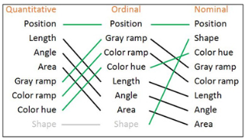

Value
Saturation
Hue
From Ben Jones, Visualizing Data with Tableau, p9

Slide 42
4. Make important comparisons easy

Slide 43
Back to the 5 hypothetical candidates at 3 time points:
Walter Hickey at Business Insider

Slide 44
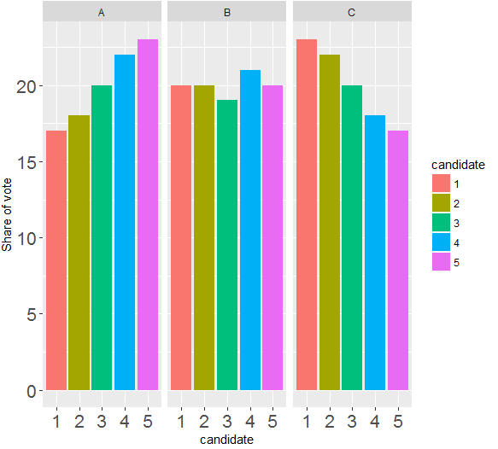
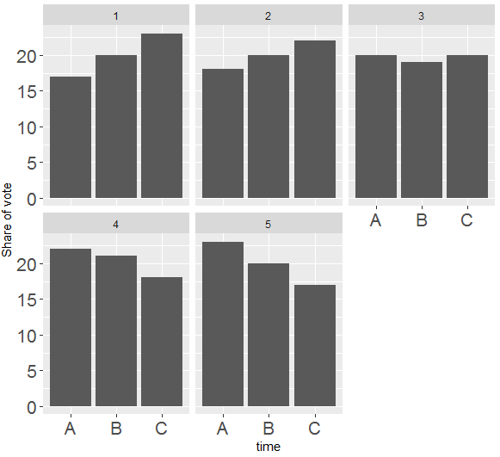
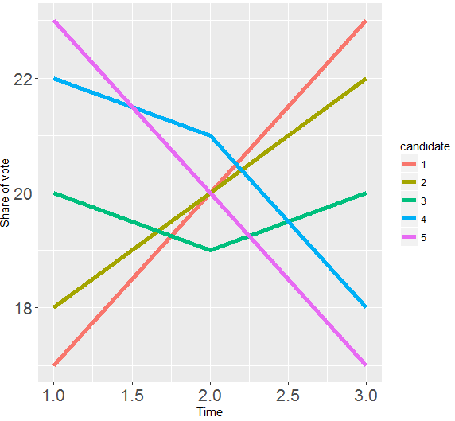
Alternative takes:
In groups;
What are the variables (think: data columns)?
For each graph, which EPTs are used to map the variables?
Which graph(s) have redundant EPTs?
Which graph(s) should be used to answer which candidate is doing the worst at Time B? Why?
Which graph(s) should be used to answer candidates are losing steam? Why?
Which graph(s) should be used to answer which candidate has the most momentum in the race? Why?

Slide 45
Given what you know now, revisit the two NYT vizzes.
In groups;
What are the variables?
For each graph, which EPTs are used to map the variables?
Are the EPT choices appropriate?
Are the EPT choices effective?
Are important comparisons made easy?

Slide 46
Graph 1
http://nyti.ms/2pC2HZv

Slide 47
Graph 2
http://nyti.ms/2qwlIS6

Slide 48
References & Resources
Cleveland, William S. The elements of graphing data. Monterey, CA: Wadsworth Advanced Books and Software, 1985.
Cleveland, William S., and Robert McGill. "Graphical perception: Theory, experimentation, and application to the development of graphical methods." Journal of the American statistical association 79:387 (1984): 531-554.
Robbins, Naomi B. Creating more effective graphs. Chart House, 2013.
Tufte, Edward. The Visual Display of Quantitative Information. Graphics Press; 2nd edition. 1983.

